Slide 1
Oracle Partner Journey
Csitneki Attila
Partner Sales Account manager
Alliance & Channel
attila.csitneki@oracle.com
30. October 2025
Notes:
For more than 40 years, Oracle has been working closely with partners to help drive joint customer success and business momentum.
Yet, even with all the success we’ve helped customers achieve, they still need our help. With uncertainty all around – as the world continues to throw us curve balls – and new opportunities knocking at our door – like that little thing called AI – organizations must be agile; they need to find new ways to reduce costs, and they must continue to get closer to their customers. But pushing the boundaries often requires bold decisions. We’ve been there too – at Oracle, we’ve had to deal with the psychology around change that leads people back to the status quo.
And that’s where you and our joint efforts come in. Our customers need us to help them meet their evolving needs and continue executing on their goals. They need our holistic solutions, our guidance, and our leadership.
That’s why we believe the opportunity to take our partnerships and joint success to the next level has never been greater and why we’re so excited about our newly enhanced partner program.

Slide 2
Key advantages over previous OPN program
Enhanced Program | Previous Program
Broader range of benefits included with no additional fees or qualification requirements | Benefits beyond basic OPN membership required a track enrollment and Expertise
Choice of incentives—monetary payout or Oracle Partner Credits | Monetary incentive payout option only
5 Oracle University training seats—all Learning Subscriptions | 5 Oracle University training seats—Cloud Learning Subscriptions only
$5,000 enabler for use with any available OPN environment | $3,000 in Universal Credits for use with OCI only
Integration qualification included for all partners | Integration qualification only for ISV partners
Business and technical assessment support funding included | Not available
Access to Joint Account Planning with Oracle Sales teams | Not available
2
Copyright © 2025, Oracle and/or its affiliates. All rights reserved.
Notes:
This slide shows some of the key advantages of the enhanced program over the previous program.
We can also review what you’ve been spending in the previous program and provide a more tailored ROI comparison.

Slide 3
Choose your partnership path, benefits, and incentives
Level 1
5 seats for advanced delivery and success training on Oracle’s entire product portfolio
Enabler for dev/test environments
3
Copyright © 2025, Oracle and/or its affiliates. All rights reserved.
Notes:
Let’s start with the pathways for partnering and the benefits we’re offering. We offer three levels of partnership, but we’re going to focus on Level 1.
In this level, we put you on a path of accelerating your business momentum and driving customer success. It starts with training and dev/test environments that we provide right out of the gate.

Slide 4
Choose your partnership path, benefits, and incentives
Level 1
5 seats for advanced delivery and success training on Oracle’s entire product portfolio
Enabler for dev/test environments
Level 2
100 seats for advanced delivery and success training on Oracle’s entire product portfolio
125K Oracle Partner Credits for use on added benefits
Managed regional GTM collaboration
Level 3
500 seats for advanced delivery and success training on Oracle’s entire product portfolio
750K Oracle Partner Credits for use on added benefits
Managed global GTM collaboration
Global Partner Marketing Manager
Private offer listing
Included Benefits Across Levels
Added Benefits Unlocked with Oracle Partner Credits
Training and Enablement:
Sales-readiness training
Foundational delivery & success training
GTM Collaboration:
Foundational marketing resources & activities
Business & technical assessment funding for qualified opportunities
Sales assets OCI pre-sales support
Joint account planning & selling
Oracle Marketplace listing
Technical Accelerators:
Integration qualification
Success Support:
Foundational success resources
Training and Enablement:
Advanced delivery & success training
GTM Collaboration:
Advanced marketing resources & activities
Technical Accelerators:
Integration validation
Dev/test environments
Solution architect & migration services
Success Support:
Partner Success Manager
Partner Technical Account Manager
+ Earn Monetary Incentives or Oracle Partner Credits for More Benefits
Note: Oracle Marketplace listings, including private offer listings, are not available in all countries..
4
Copyright © 2025, Oracle and/or its affiliates. All rights reserved.
Notes:
Before I move on talk about the enhanced program benefits in more detail, I just wanted to show the other two Levels in case you’re wondering what they include. As you see, they offer more seats, Oracle Partner Credits upon enrollment, and some additional benefits.
The investment levels are also higher -- $100K for Level 2 and $500K for Level 3.

Slide 5
Choose your partnership path, benefits, and incentives
Level 1
5 seats for advanced delivery and success training on Oracle’s entire product portfolio
Enabler for dev/test environments
Included Benefits Across Levels
Included Benefits Across Levels
Training and Enablement:
Sales-readiness training
Foundational delivery & success training
GTM Collaboration:
Foundational marketing resources & activities
Business & technical assessment funding for qualified opportunities
Sales assets OCI pre-sales support
Joint account planning & selling
Oracle Marketplace listing*
Technical Accelerators:
Integration qualification
Success Support:
Foundational success resources
+ Earn Monetary Incentives or Oracle Partner Credits for More Benefits
Note: Oracle Marketplace listings, including private offer listings, are not available in all countries..
5
Copyright © 2025, Oracle and/or its affiliates. All rights reserved.
Notes:
Beyond those benefits, this pathway provides the ability to earn either monetary incentives OR Oracle Partner Credits for more benefits.
Remember how I mentioned that you choose the path, the benefits, and the incentives? Right here, we’re giving you the choice of choosing the incentive for helping us drive revenue. Let me explain.
When you help us win new cloud business, drive expansions, or drive OCI consumption growth, you’ll have a choice.
Each year, you can choose whether you want to receive a monetary incentive – the same as how incentives are paid today – or you can get paid at a sooner date and at a higher rate with Oracle Partner Credits as incentives earned during that year.
Now let me show you how you can use Oracle Partner Credits.

Slide 6
Choose your partnership path, benefits, and incentives
Level 1
5 seats for advanced delivery and success training on Oracle’s entire product portfolio
Enabler for dev/test environments
Level 2
100 seats for advanced delivery and success training on Oracle’s entire product portfolio
125K Oracle Partner Credits for use on added benefits
Managed regional GTM collaboration*
Included Benefits Across Levels
Added Benefits Unlocked with Oracle Partner Credits
Training and Enablement:
Sales-readiness training
Foundational delivery & success training
GTM Collaboration:
Foundational marketing resources & activities
Business & technical assessment funding for qualified opportunities
Sales assets OCI pre-sales support
Joint account planning & selling
Oracle Marketplace listing
Technical Accelerators:
Integration qualification
Success Support:
Foundational success resources
Training and Enablement:
Advanced delivery & success training
GTM Collaboration:
Advanced marketing resources & activities
Technical Accelerators:
Integration validation
Dev/test environments
Solution architect & migration services
Success Support:
Partner Success Manager
Partner Technical Account Manager
+ Earn Monetary Incentives or Oracle Partner Credits for More Benefits
Note: Oracle Marketplace listings, including private offer listings, are not available in all countries..
6
Copyright © 2025, Oracle and/or its affiliates. All rights reserved.
Notes:
Oracle Partner Credits unlocks even more benefits … things you might otherwise have paid cash for, like more training, more dev/test environments, and more marketing. Plus, additional benefits like migration services and managed go-to-market collaboration, where we name specific individuals on our Marketing and Sales teams to align with your organization on business plans and drive joint activities from lead generation to deal close.
How you use those Oracle Partner Credits is up to you. Want to focus on marketing with Oracle? No problem, you can use all the credits that you accrue on activities like events, webinars, customer workshops, and marketing campaigns targeted at Oracle’s install base.
Prefer to focus on more training so you can skill up more implementors and drive your business momentum across the globe? Great. You can spend all or some of your Oracle Partner Credits on training too.
Want a Partner Success Manager who will provide hands-on support to your team and assist on particularly complex projects? Or want a Technical Account Manager who will help you with your service requests and accelerate the resolution of your tickets?
The choice is yours.
Now for us to deliver all these benefits that help our partners win and succeed with us, all partners are asked to make an annual investment. The Level 1 investment is $5000, and I want to mention one other thing to keep in mind -- partners can use Oracle Partner Credits for membership renewals if they prefer not to pay cash after the first year. This means that if you elect to use your credits for renewals and you’ve accrued sufficient Partner Credits, you may never need to pay for your membership again, and you will get the benefits offered for your membership level.

Slide 7
Training
Training & Enablement
GTM Collaboration
Technical Accelerators
Success Support
7
Copyright © 2025, Oracle and/or its affiliates. All rights reserved.
Notes:
Now let me provide more details on the menu of benefits, starting with Training & Enablement.
As I mentioned earlier, we want to ensure you and your teams are sales ready, delivery ready and success ready.
So, what are the resources we’re providing to help with that?

Slide 8
SALES READY Learn to sell Oracle solutions
Industry, product, and persona messaging to support customer outreach
Portfolio and value positioning including unique benefits and features
Account planning methodology to drive sales productivity and performance
Sales and demo methodology to showcase the value of Oracle solutions
1
SALES READY Learn to sell Oracle solutions
DELIVERED
VIA
Digital learning paths Online labs
Live workshops
8
Copyright © 2025, Oracle and/or its affiliates. All rights reserved.
Notes:
Let’s start with helping drive sales efficiency with training that will prepare your teams to sell.
What you’ll get here is the same as what we provide our own sales teams, and the right-hand side of this slide gives you a flavor of that training.
It includes enablement on positioning Oracle – across each industry and persona type and with messaging that helps explain the value we deliver to help our customers overcome their challenges and achieve their goals.
It also includes training on best practice methodologies for account planning, selling, demo’ing, and more.

Slide 9







DELIVERY READY Learn best practices for implementation
2
Digital learning paths Online labs
Live workshops
DELIVERED
VIA
Business Plans
Cloud Architecture
Data Migration
Change Management
Project Management
Provisioning
Testing
9
Copyright © 2025, Oracle and/or its affiliates. All rights reserved.
Notes:
Those are the ways we help you sell. We also help you learn how to implement successfully.
On this slide, you see the key milestones of a project. We’re going to train you on every element of a successful go-live, from planning to change management – just like we train our own internal teams.
.

Slide 10
Training & Enablement
GTM Collaboration
Technical Accelerators
Success Support
10
Copyright © 2025, Oracle and/or its affiliates. All rights reserved.
Notes:
Let’s talk about our GTM Collaboration and the benefits we provide to help us win together, starting with the marketing benefits to accelerate your momentum.

Slide 11
Create and close more pipeline by conducting joint account planning and selling with Oracle Sales
Align on GTM plans, including:
Target industries
Target countries
Target accounts
Relationship maps
Whitespace maps
Strategy maps
Action plans
NEW Collaborative Customer Engagement (CCE) System makes it simple for partners to submit target accounts and pursuits and for Oracle Sales to see the opportunities to sell with partners
11
Copyright © 2025, Oracle and/or its affiliates. All rights reserved.
Notes:
This slide talks about our collaboration and how we’ll jointly sell together. Just as we do across Oracle sales teams where we develop unified account plans, we invite you to develop joint account plans with our teams. By targeting specific industries, countries, and accounts, and developing account plans with clear action items, we can help our teams stay focused and aligned so they can more productively win together.
To facilitate our joint work, you will have access to our Collaborative Customer Engagement System. Through this system, you will be able to submit target accounts for Oracle review and submit opportunities to be assigned to an Oracle sales territory/team.

Slide 12
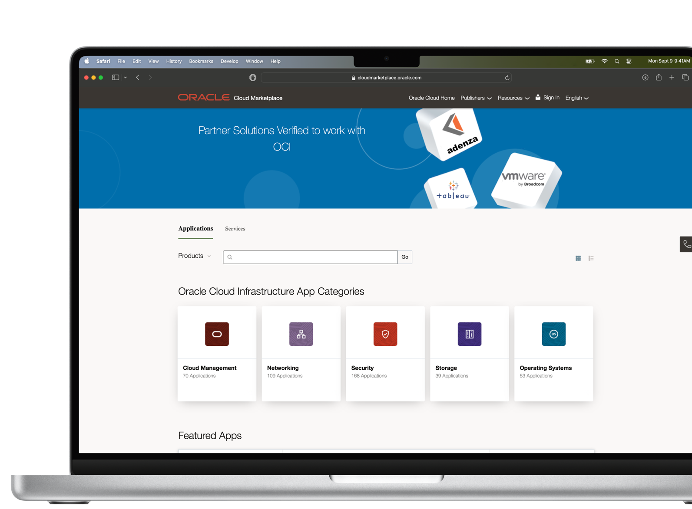



Expand your reach with a listing on the Oracle Marketplace
Access to Oracle’s customer base
Easy button for customers to purchase
Ability for customers to purchase with Oracle Universal Credits
12
Copyright © 2025, Oracle and/or its affiliates. All rights reserved.
Notes:
Another benefit available at all levels to help accelerate and expand your sales efforts is the Oracle Marketplace.
The Oracle Marketplace is the easy button for customers to procure your technology and services.
Not only do we provide one-stop shopping for our customers, but we also enable many of our customers to leverage a portion of their Oracle cloud commit spend on your solutions.
That means Oracle customers can leverage their already-approved IT budget for your solutions.

Slide 13
Training & Enablement
GTM Collaboration
Technical Accelerators
Success Support
13
Copyright © 2025, Oracle and/or its affiliates. All rights reserved.
Notes:
Let’s move to another set of benefits that you asked for and that we’re providing – Technical Accelerators.
At all partnership levels we’re providing integration qualification, and with Oracle Partner Credits we’ll provide integration validation as well. What do those mean?

Slide 14





Oracle environments for testing, development, and demonstration
Oracle Fusion Cloud Applications
Oracle Industry Cloud Applications
Oracle Cloud Infrastructure (OCI) IaaS and PaaS services
SaaS Demo Instances
Note: This benefit can be unlocked with Oracle Partner Credits.
14
Copyright © 2025, Oracle and/or its affiliates. All rights reserved.
Notes:
Another benefit in the Technical Accelerators category is environments for testing, development, and demonstration, which can be unlocked with Oracle Partner Credits. This includes:
Fusion AND Industry Application instances
Oracle Cloud Infrastructure
Demo instances with pre-installed and pre-configured Oracle SaaS applications
But there’s more!

Slide 15
Training & Enablement
GTM Collaboration
Technical Accelerators
Success Support
15
Copyright © 2025, Oracle and/or its affiliates. All rights reserved.
Notes:
Now that we’ve covered the Training & Enablement benefits, along with the GTM Collaboration benefits and Technical Accelerators, let’s move to Success Support.

Slide 16

Leverage Oracle experts to help you succeed every time
Partner Technical Account Manager
Accelerates issue resolution times across your customer projects
Partner Success Manager
Collaborates with you on a success plan for developing a leading Oracle practice and ensuring your teams deliver successful projects the first time, every time
Note: Both these benefits can be unlocked with Oracle Partner Credits.
16
Copyright © 2025, Oracle and/or its affiliates. All rights reserved.
Notes:
Beyond the Cloud Success Navigator and Cloud Quality Standards, we also offer access to expert resources.
With your Oracle Partner Credits, you can leverage a Partner Technical Account Manager to accelerate issue resolution times and/or a Partner Success Manager to help you develop a success plan for your Oracle practice and consistently drive customer success.
Let me say a bit more about Partner Success Managers. They’re focused on supporting and enabling our partners through all phases of a customer’s business transformation journey. They can help improve the quality of managed-partner delivery by:
Proactively supporting you in achieving quality delivery outcomes
Utilizing Oracle’s Cloud Quality Standards to proactively guide and monitor your activity through all phases: Mobilization, Delivery, and Post Go-Live.
Building & managing Partner Success Plans to overcome challenges through prescribed partner enablement.
Managing all at-risk customer implementations back to green health status.
Both these benefits can be unlocked with Oracle Partner Credits.

Slide 17
Cloud Incentives details
New cloud business and expansions
Monetary incentives paid at 5% ARR at go-live
Oracle Partner Credits paid at 10% at Oracle deal booking
OCI consumption growth
Monetary incentives paid at 7.5% ACR above ARR, with max payout of 15% of ARR
Oracle Partner Credits paid at 15% ACR above ARR, with max payout equivalent to 30% of ARR
Public sector momentum
Oracle Partner Credits paid at 10% ARR, following close of 10+ public sector deals that total $250K+ or Oracle ARR
Note: Additional criteria and terms apply as noted in the Incentive Resources Center.
17
Copyright © 2025, Oracle and/or its affiliates. All rights reserved.
Notes:
Now Iet me provide more details on the incentives for helping drive Oracle revenue, starting with the incentives for all levels.
As I mentioned previously, for new cloud business and expansions, the monetary option is paid at a rate of 5% ARR at go-live, while Oracle Partner Credits will accrue sooner - at deal booking by Oracle - and at a higher rate of 10% ARR.
The incentive based on OCI consumption growth is a one-time incentive calculated at 7.5% of the “Annualized Consumption Rate” above ARR for the monetary option, and 15% for the credit option.
We’re also offering an all-new incentive. When a partner closes 10 or more new or expansion public sector deals that in total amount to USD $250k+ ARR, the partner will be eligible to earn 10% of ARR in Partner Credits.
There are no limits to the incentives you can earn during the subscription period.

